Slide 1
Local Leadership in Humanitarian Crisis Management: Evidence from Nigeria
28th May 2025

Slide 2
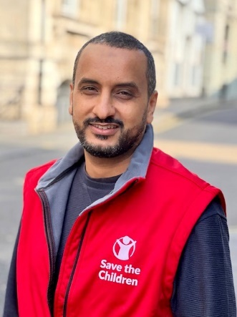
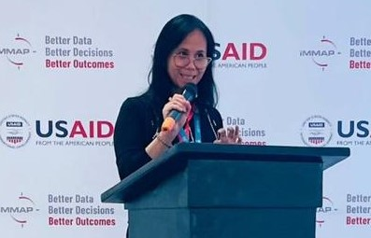
Today’s host & panel
Harvey Duncan Nigeria country office Director, Save the Children
Abdurahman Sharif Senior Humanitarian Director, Save the Children International
Esty Sutyoko Deputy Head of Office in OCHA Nigeria
Peter Michael Egwudah Head of Civil Society Organisations (CSO) Forum – Adamawa State
Ibrahim Ishaku Balami Executive Director / Co-Founder FRAD
Nancy Mureti Head of Regional Centres, HLA / Save the Children

Slide 3
Agenda
Introduction
Presentations:
3 presentations
Q&A
2 presentations
Q&A and wrap up
Q & A & discussion

Slide 4
Housekeeping
Type your questions into the Q & A, for our discussion at the end
Please keep questions and comments respectful & on-topic
You can turn on captions (including translated captions) by clicking ‘More’ at the bottom of your screen, then
….. and selecting your language

Slide 5
Defining localisation and locally led action
Localisation: Focuses on efficiency’ between donors and humanitarian organizations to reduce the costs and improve the effectiveness of humanitarian action. “making principled humanitarian action as local as possible and as international as necessary”
“Locally led development is the process in which L/NAs – encompassing individuals, communities, networks, organizations, private entities, and governments – set their own agendas, develop solutions, and bring the capacity, leadership, and resources to make those solutions a reality.” – USAID, Locally Led Development Factsheet.
The OECD emphasize the L/Nas have agency (self direct/autonomy) … L/Nas account for and learn, with or without the support of international development co-operation.” Framing DAC Member Approaches to Enabling Locally Led Development.

Slide 6
Dimensions
ALNAP: Resources, Agency, and Ways of being

Slide 7
Identifiying the challenges & opportunities of integrating local leadership approaches into humanitarian response &mobilising local funding.
- Peter M. Egwudah. Chairman: Network of Adamawa Non Governmental Organizations' (NANGO).

Slide 8
CONTEXT
Leadership in whatever form it exist within a humanitarian context must ensure or demonstrate that aid is delivered without discrimination, must be autonomous and devoid of political, religious or ethnic objectives, must not take side in the cause of duty, must not discriminate.
Aid delivery should be on the bases of need and the most affected and finally; humanitarian action should protect lives and ensure respect for human dignity. According to OCHA, these principles are often rooted in international humanitarian law (IHL) and are key for maintaining and establishing access to those in need, whether in a disaster or a complex emergency.

Slide 9
CHALLAENGES
Weak governance structure and coordination.
Poor visibility.
Low expertise and skills among personnel's.
Limitation to funding.
High turn over of personnel's due to poor remuneration and better condition of service.
Highly vulnerable and exposed to various categories of risk such as; Fraud, corruption, exploitation, kidnapping and killing.
Poor knowledge of IHL and HP.
Scattered and most time not coordinated.
Have no voice in decision making process.

Slide 10
OPPORTUNITIES
Close proximity to the affected population. ( significant number of the L/NGOS are indigenous and better understand the issues and contexts.
Its ubiquitous nature meant that if well harnessed and supported can be useful for advocacy and also to provide humanitarian assistance to affected population in hard to reach locations.
Working with or through L/NGOS guaranty's ownership and sustainability of projects and also; save cost on logistics and overhead. The extra budget cost saved, can be utilized for life saving effort.
In view of the ongoing reset process, investing in the local leadership and governance structures of L/NGOs will not only speed up the actualization of the localization agenda but also ensure aid is delivered effectively and efficiently.

Slide 11
Effective Local Leadership Practices (Nigeria Context)
Speaker: Ibrahim Ishaku Balami
Executive Director
Future Resilience and Development Foundation ( FRAD Foundation)
Date: 28th May, 2025

Slide 12
Experiences/Benefits of Local Leadership
Implementation:
Promote sustainability and ownership, when responses is led by communities as lead. ( Bulama, women leaders, youth groups, CJTF, religious leaders etc.)
Sectoral level:
Local leadership Participate in sharpening the sector response, Coordination continuity in the case of CP AOR ( GPON Co-leading, FRAD Supporting IM)
Funding mechanism
SCI Case study of HF response in Nigeria, following that response, we currently have active projects in all LGAs that we have implemented the HF funds.
Advocacy :
Local Partners championing advocacy initiatives and are being endorse by the government, State Policy on education ( CATAI, Disability law FRAD & C3HD)
Local leadership has increase
Trust
Inclusion
Capacity Building
Partnership
Increase impact
Value for money

Slide 13
Local Leadership can be effective when focus in on
Humanitarian Initiative Promote local leadership ( OCHA Case study of localizing funding)
Equal Partnership ( Including Co-design)
Realistic demands for leadership and partnership
Access to Flexible fundings
Mentorship ( Not shadow shaping or cloning )

Slide 14
Contact
Humanitarian Leadership Academy:
www.humanitarianleadershipacademy.org
info@humanitarian.academy
FRAD:
https://fradfoundation.org/contacts/
bighearts.donation@mail.com
CISCOPE:
https://ciscopenigeria.org/
info@ciscopenigeria.org

